Slide 1
Project Application Development
Bindu, Assem, Justice, Joud and Justin

Slide 2
Introduction
General Information
Sub Questions
Main Research Question
Summary and Conclusion

Slide 3
General Information
Project Plan
Meetings
Agendas and Minutes

Slide 4
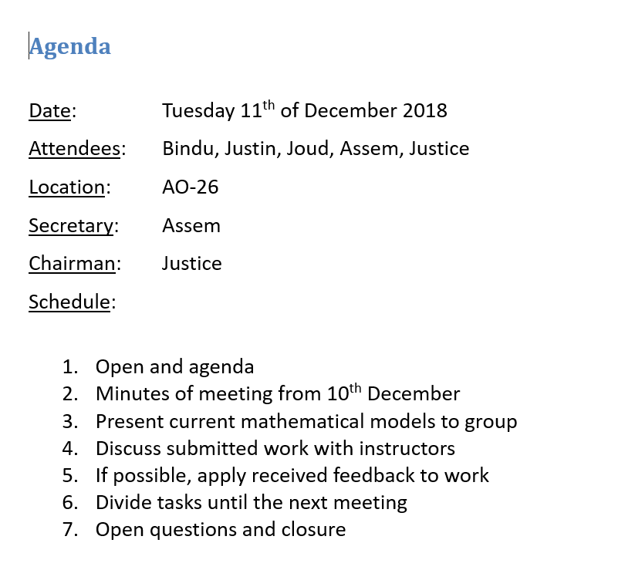

Slide 5
What is the best ethically acceptable measure which can be taken to improve the ecological balance in the Oostvaardersplassen?
Needs of the client
Available models
Variables to be used
Models simple enough
Application

Slide 6
What are the needs of the client?
Sample data blah blah

Slide 7
What mathematical models are already available?
Sample data blah blah

Slide 8
What variables should be taken into consideration when creating mathematical models?
Sample data blah blah

Slide 9
Which models are simple enough to use with the data acquired?
Sample data blah blah

Slide 10
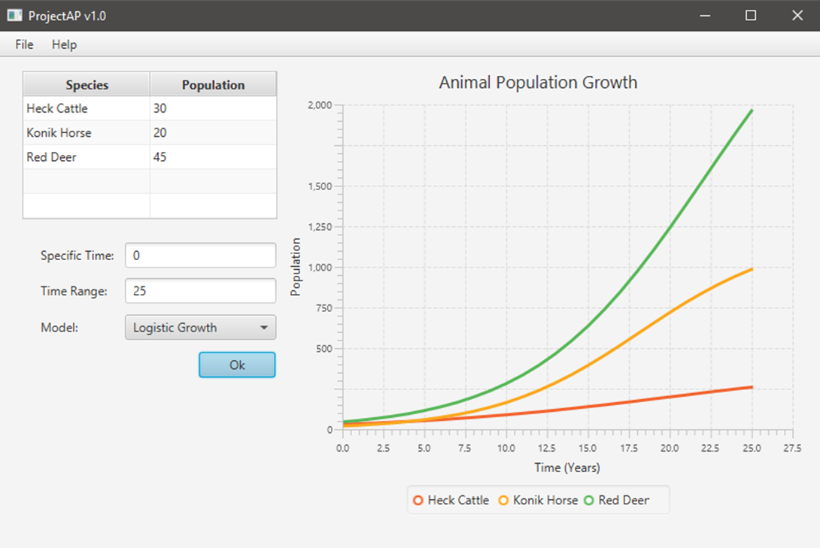
How can the results of the models be displayed in an application?

Slide 11
What is the best ethically acceptable measure which can be taken to improve the ecological balance in the Oostvaardersplassen?
Still unknown
Application unable to give solution
Mathematical models not realistic enough

Slide 12
Summary and Conclusion
Questions?

